Slide 1
MACHINE LEARNING · MINI PROJECT PRESENTATION
Predictive Modeling
for Life Insurance
Risk Assessment
An end-to-end machine-learning pipeline that turns applicant data into three interpretable risk tiers.
00102102026
ADITI VERMA
Notes:
This presentation follows an end-to-end machine-learning pipeline: exploratory analysis, preprocessing, target reframing, model comparison, evaluation, and limitations.
1

Slide 2

PRUDENTIAL LIFE INSURANCE ASSESSMENT
The project frames underwriting complexity as a modeling problem
INPUT
TARGET
QUESTION
59,381
1 → 8
What changes the prediction?
Applicants, with 126 predictor features spanning product, insured, employment, medical, family, and keyword history.
Ordinal response values: 1 marks the highest risk, 8 the lowest.
How do EDA, preprocessing, and model choice affect risk-tier prediction?
Goal: predict risk category from 126 raw applicant attributes.
Notes:
The project begins with a high-dimensional underwriting dataset and an ordinal response. The central question is how analytical and modeling choices shape the resulting risk-tier prediction.
2

Slide 3
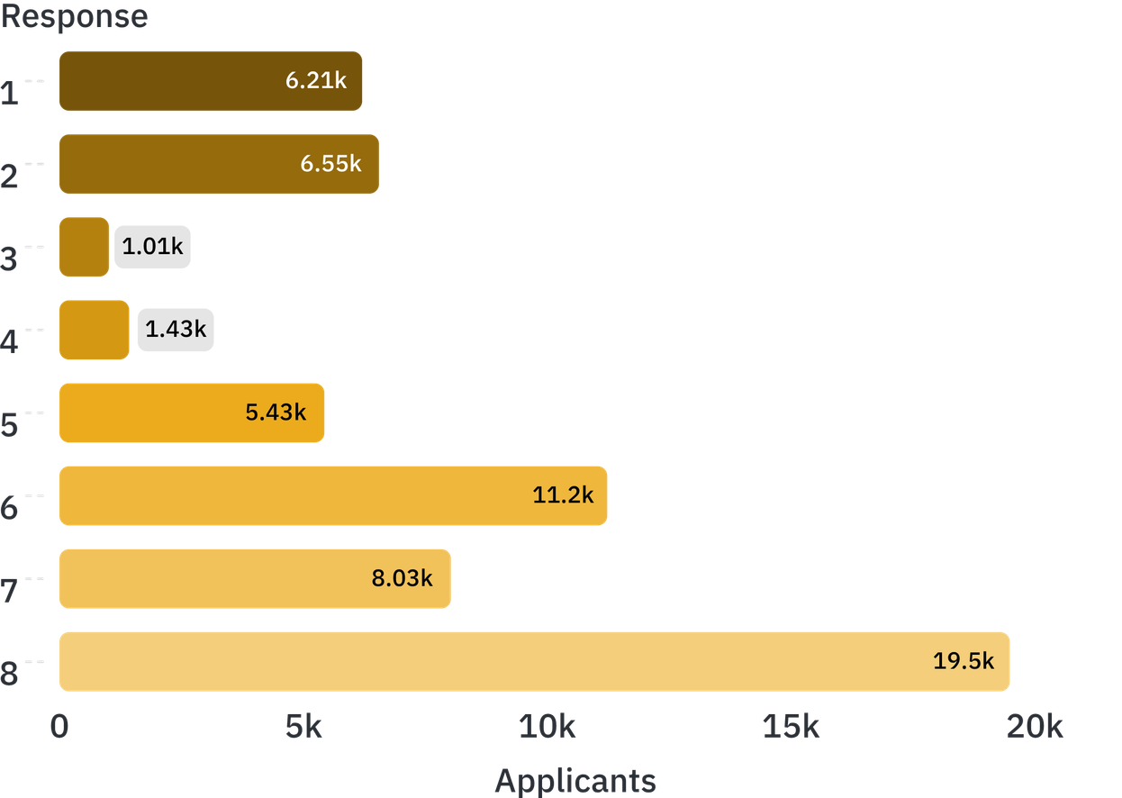
EDA & RISK INSIGHTS
Exploratory analysis revealed class imbalance and structural missingness
Response 8 dominates.
It holds 19,489 records; Responses 3 and 4 hold only 1,013 and 1,428.
Missingness is structural.
Medical_History_10 is 99.0% missing and Medical_History_32 is 98.2%. Eight columns exceeding 40% missing were dropped before modeling.
COLLAPSE EIGHT RESPONSES INTO THREE WORKING TIERS FOR MORE STABLE, INTERPRETABLE CLASSIFICATION
Notes:
The target is strongly imbalanced, and missingness is concentrated in medical and family-history fields. These findings motivate the move from eight responses to three working tiers.
3

Slide 4
PREPROCESSING
Preprocessing turns messy applicant data into model-ready features
01
02
03
04
Drop severe missingness
Drop a weak field
Impute remaining gaps inside the pipeline
Match scaling to the algorithm
Remove columns with more than 40% null values.
Drop Product_Info_2.
Scale inputs for Logistic Regression and Linear SVM; omit scaling for tree models.
Apply median imputation within model pipelines.
These steps address heterogeneous data, missing medical history, and algorithm-specific assumptions.
Notes:
The preprocessing sequence handles severe missingness first, removes Product_Info_2, imputes remaining gaps within the pipeline, and then applies scaling only where the algorithm requires it.
4

Slide 5
TARGET REFRAMING
Collapsing eight responses into three risk tiers improves stability and interpretability
The mapping simplifies the eight-level ordinal problem, making classification more stable and interpretable.
WORKING TIER
WORKING TIER
WORKING TIER
−1
0
1
High risk
Medium risk
Low risk
Encoded as −1 in the report's label scheme.
Responses 1–7, encoded as 0.
Response 8 alone, encoded as 1.
Trade-off: the mapping removes some ordinal detail.
Notes:
The target transformation is explicit: high, medium, and low risk replace the original eight response values. This improves stability and interpretability, but some ordering detail is lost.
5

Slide 6
METHODOLOGY
The pipeline separates data preparation from model behavior
This structure makes preprocessing repeatable and reduces leakage risk.
Split
Cross-validate
Tune
Score
A 75/25 split: 59,359 training and 19,787 test samples, with random_state=1.
StratifiedKFold preserves class distribution across folds.
RandomizedSearchCV explores six settings per model family.
Quadratic Weighted Kappa (QWK) is the primary metric; weighted F1 is tracked alongside it.
Linear models: median imputation, then StandardScaler, then estimator. Tree models: median imputation, then estimator, with no scaling.
Notes:
The pipeline separates the data split, stratified cross-validation, randomized tuning, and scoring. That separation keeps preparation repeatable while reducing leakage risk.
6

Slide 7
MODEL FAMILIES
Each algorithm imposes a different bias on the same data
All models share one preparation and tuning framework, so the comparison is like-for-like.
LINEAR
LINEAR
NONLINEAR
ENSEMBLE
ENSEMBLE
Logistic Regression
Linear SVM
Decision Tree
Random Forest
XGBoost
Max-margin linear boundaries; C tuned with balanced class weights.
Interpretable nonlinear rules; max_depth and min_samples_split tuned.
Boosting captures complex interactions by learning from prior errors; rounds, depth, and learning rate are tuned.
Linear baseline; C tuned over 0.01–10 with balanced class weights.
Bagging reduces variance across trees; n_estimators, depth, and split size are tuned.
Shared preparation; different assumptions about decision boundaries, variance, and feature interactions.
Notes:
The comparison spans linear baselines, an interpretable nonlinear tree, and two ensemble approaches. Their assumptions differ, while the preparation and tuning framework remains common.
7

Slide 8
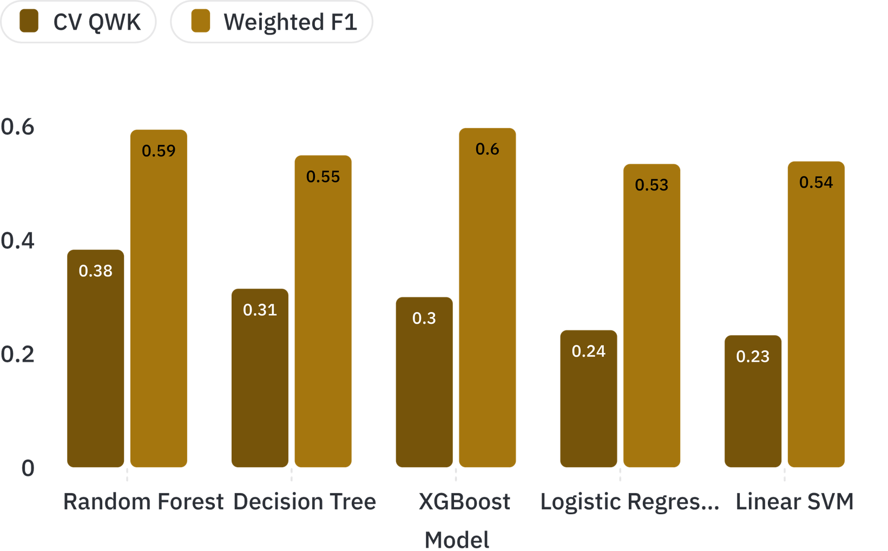
RESULTS & MODEL COMPARISON
Tree-based models outperform linear baselines on QWK
0.3825
Random Forest CV QWK
Random Forest leads on QWK; XGBoost has the highest weighted F1 at 0.5964.
Linear models trail on QWK (0.2321–0.2411), while weighted F1 ranges from 0.5332 to 0.5964 across all five models.
Notes:
Random Forest leads on the primary QWK metric at 0.3825. XGBoost has the highest weighted F1 at 0.5964, showing why metric selection matters.
8

Slide 9
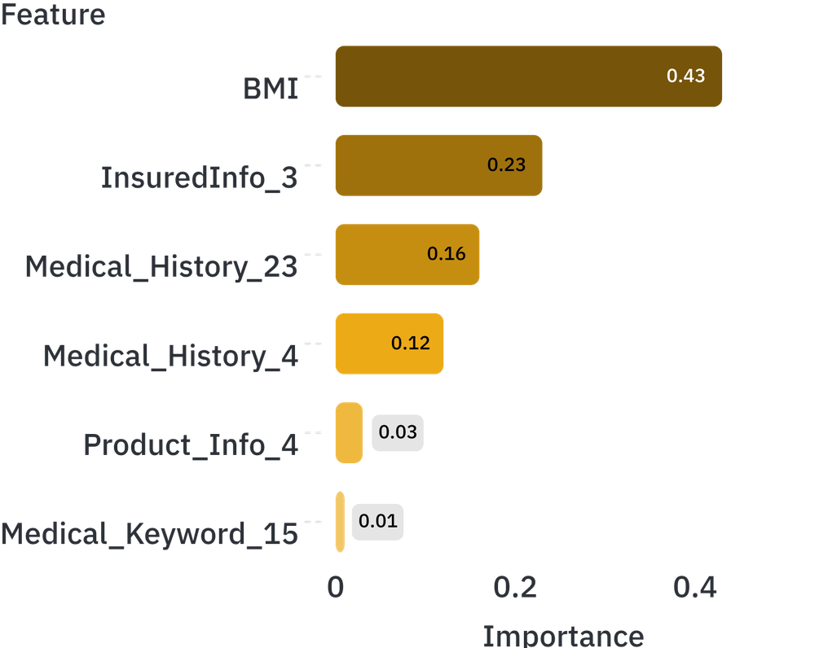
INTERPRETATION
Even the strongest model makes meaningful tier errors
Reported test metric | Value
Accuracy | 0.5432
QWK | 0.3101
Weighted F1 | 0.5501
Precision | 0.5961
Recall | 0.5432
ROC-AUC | 0.7438
Top feature-importance ranking
The middle tier is the largest source of ambiguity in the reported test matrix: 4,918 of 10,029 middle-tier applicants are classified correctly. BMI leads the feature ranking, followed by InsuredInfo_3 and medical-history variables.
Notes:
The reported test results are meaningful but imperfect. The middle tier is the largest source of ambiguity, while BMI, InsuredInfo_3, and medical-history variables provide the strongest reported feature signal.
9

Slide 10
NEXT MODELING STEP
Three gaps define the next modeling step
01
02
03
Class imbalance
Interpretability
Target compression
Overall accuracy can mask weak recall for smaller or higher-risk groups; SMOTE is one mitigation the report names.
Unlike a single tree or linear model, a forest of hundreds of trees cannot be drawn as one flowchart for review by a clinician.
Collapsing eight responses into three tiers simplifies the task but loses granularity.
RECOMMENDED NEXT MODELING STEP
Compare the original eight-class target, test SMOTE or other resampling, add repeated stratified validation or multiple seeds, tune model settings, and reconcile the metric-selection discrepancy before naming a model.
The current pipeline is a useful baseline; stronger validation of the target definition, imbalance strategy, and evaluation metric should guide the final model choice.
Notes:
The next modeling step should address imbalance, explainability, and target compression. It should also reconcile the difference between the table's QWK result and the report's stated conclusion rather than treating either model as the settled winner.
10

